Slide 1
ECSC 325.200 Web Server Administration
Spring 2025 – Week 12-1 – April 1st, 2025
Network and File System Reviews, Data Centers
Prof. Jason Patalon

Slide 2
Objectives
Cloud Review
DevOps Review
Data Center Review
Parted and FDisk
Show & Tell
Notes:
Easy may be relative…

Slide 3
Weekly Info
“Go as far as you can see, and you will see further.” - Zig Ziglar
Attendance
Assignment 11 due April 2nd
Assignment 12 due April 9th
Assignment 13 due April 16th
Good of the class
Final Exam
300 Points
Hands-on: 40 points (similar to many assignments)
Short/long answer: 260 points (similar to midterm)
Tuesday April 29th, 2025
5:00PM – 7:00PM
Stuxnet Virus Video?!
https://www.youtube.com/watch?v=J07N1KXOyfk
10 Minute runtime
Professor online most of the days (checking email)
8:00 AM to 8:00 PM
Except lunch…
Notes:
Lunch sometime between 12:00 - 2:00 pm

Slide 4
Recap and Review
The next few weeks…
Security and Authentication
Firewalls and Filters
Network Services
Monitoring & Performance Tuning
Cloud
Final Exam!
Corrections, updates, etc.
Update to our configs – coming later!
Questions from previous classes?
Feel free to ask during class, after class, email, office hours…
Etcetera

Slide 5
Objectives
Administrative
Monitoring Review
Multi-homed Networking Review
File Systems Review
Cloud Review
DevOps Review
Data Center Review
Parted and FDisk
Show & Tell

Slide 6
Semester Grades Review
Grades are assessed according to the following breakdown:
Description Percentage Total Points Graded points Remaining Points
Midterm Exam 21.42% 300 300 0
Final Exam 21.42% 300 0 300
Attendance (20-28) 6.00% 84 57 27
Assignments (11-14) 51.14% 716 426 290
Total 100.0% 1400 783 617
Assignment 14 – 140 Points, more detail & input expected!
Final – 300 Points – Hands on configuration portion, mostly 2nd half content
Not including today’s attendance points
AWS Bonus Assignment 50 points?

Slide 7
Assignment 10 Review
Add a permanent NFS mount with the default mount options, no backups, and no disk checks.
Week 9
Install NFS Client tools (should already be installed)
dnf -y install nfs-utils
Create the local folder to mount at:
mkdir /share
Add network mount to filesystem configuration file /etc/fstab
147.64.243.110:/share /share nfs bg,rw,sync,hard,intr 0 0
Mount any missing filesystems from /etc/fstab file
systemctl daemon-reload
mount -a
Check that filesystem has been mounted
df -h /share
147.64.243.110:/share 16G 1.8G 14G 12% /share

Slide 8
Assignment 10 Review
Install the vsftpd server software, the ftp client software, and configure the vsftpd service
Week 9
Install vsftpd server and ftp client
dnf install vsftpd ftp -y
Edit vsftpd configuration file: /etc/vsftpd/vsftpd.conf
anonymous_enable=YES
anon_upload_enable=YES
anon_root=/var/ftp
anon_umask=022
Set permissions on anonymous upload directory
chown -R root:ftp /var/ftp/pub
chmod -R ug+rwX,o+rX,o-w /var/ftp/pub
ls -lah /var/ftp
Start vsftpd service and enable to run on system startup
systemctl enable vsftpd.service && systemctl start vsftpd.service

Slide 9
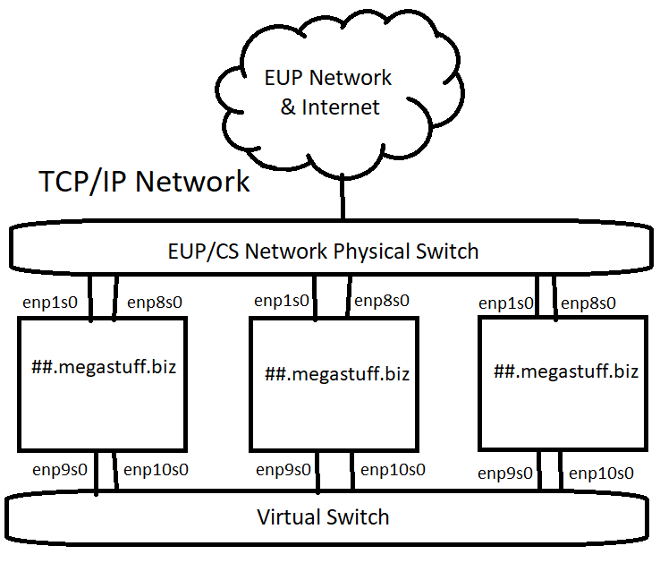
Multiple Network Configurations
Our ##.Megastuff.biz servers have network interfaces on two different networks!
Device eth0 & eth1 – EUPCS Network
enp0s3 & enp0s8 in picture
Device eth2 & eth3
enp0s9 & enp0s10 in picture
Our virtual network only exists within the hypervisor!
Only VM’s in this cluster can access the virtual switch!
We can use this separate virtual network for security, administration, backup, or other reasons!
This is network virtualization at the hypervisor layer
Logical vs. Physical
Multihoming – Connecting a device to more than one network

Slide 10
Virtual Network Configurations
We can further virtualize our network traffic using Virtual Local Area Networks (VLANs)
While all network traffic flows over the same physical links, VLAN traffic over the virtual switch is tagged within the infrastructure as a specific network
Different switch ports can be set for different VLANs
A different logical network using existing physical cables
This is virtualization at the interface or guest layer
The guest can optionally do VLAN tagging
The switch can force VLAN tagging on specific ports & traffic
Standardize, make repeatable

Slide 11
File Systems
File systems provide a method of organizing data on a storage media.
The basic building block of most Linux file systems is the i-node
The i-node is a control structure that either points to data or other i-nodes
The i-node contains info such as ownership, permissions, access/edit times, and similar.
It does not provide the file name however!
Data is broken into blocks
The smallest amount of addressable data on a device
A block may contain an entire file, or only part of the file, depending on sizes
The block size can be specified when creating the file system, such as 1KB
Blocks are grouped together into block groups
Block groups contain a copy of the superblock, a descriptor table, the block bitmap, an i-node table, and data blocks
Superblocks are the first piece of data read from a disk
A small piece of very important information, they contain the disk geometry, amount of available free space, and the location of the first i-node

Slide 12
File Systems
Some file systems use Extents instead of i-nodes
An extent is a means of representing contiguous physical blocks
Provides information about the next range of blocks
Instead of pointing to each individual block, the extent says the next X blocks belong to a specific data file.
Defragmentation is when these data blocks are spread out on the disk, with other data blocks in between.
Traditionally defragmentation was done offline
Nothing can access the disk, interrupting the defrag process
Online defragmentation became possible with newer file systems
Some filesystems allow for defragmentation of individual files
Different file systems have different features
Online defrag, online disk checking, encryption, RAID functions, compression, large disk sizes, various block sizes, deduplicaton…

Slide 13
File Systems
We use the mount command to mount a file system
We also use the umount command to unmount a system
We define our boot-time mounts in the /etc/fstab file
Ex: /dev/mapper/centos_ds1019vm-root / xfs defaults 0 0
We can use the fsck tool to diagnose and repair file system issues
File System Check (fsck) – Similar to Check Disk in Windows
Can run automatically as scheduled
Often required on boot after so many days or number of mounts
Linux typically automatically can repair issues by itself
Some times critical data may be lost, and the system may not be able to boot
While you may be able to recover from this, it is often a futile effort
If fsck finds file segments it doesn’t know what to do with, they will end up in the “lost+found” directory of that file system (if supported by the file system)
Separate mount points would have their own “lost+found” directories

Slide 14
Intro to Amazon Web Services
Started with S3 (Simple Storage services), expanded to multiple other services
Compute – Various different operating system
Create your own custom OS images to deploy from
Virtual Machines!
Auto Scaling Groups
Load Balancers
Storage – Multiple types of data storage
SSD or traditional disks for block storage
Object storage for video/image files, etc
Database – Relational databases or others (NoSQL)
Create your own databases or database management systems
Backups, availability, etc.

Slide 15
Intro to Amazon Web Services
Networking – Create your own logically separate network
Virtual Private Cloud (VPC) – Separate routes, CIDR masks, subnets, and more
Encrypted connections possible as a service
Route 53 – Cloud DNS Management
Many more services!
Email, messaging, analytics, data analysis, security, utilization, deployment services, mobile services…
Multiple ways to manage your services
AWS Management GUI Console
AWS Command Line Interface
AWS API HTTP Calls
Various SDK’s for multiple programming languages
IDE toolkits for Eclipse and Visual Studio

Slide 16
Intro to Amazon Web Services
AWS Regions
Fairly independent collections of data centers within a specific geographic area
US East, N Virginia, us-east-1
US West, Oregon, us-west-2
Asia Pacific, Tokyo, ap-northeast-1
https://www.cloudping.info/
Availability Zones
A specific zone within an AWS Region
Separate datacenters
Low latency connections between AZ’s
Provides for fault-tolerant designs
If an AZ goes offline, you can run on another AZ in that region
Geolocation!

Slide 17
Intro to Amazon Web Services
Benefits and use cases for AWS services
Faster time to deployment of new applications
Cloud backup and storage archival options
Disaster recovery strategies with AWS
Cold, warm, and hot sites
Edge locations
Content delivery networks
Keep the data cached closer to the end user
Computationally intense tasks
You’re only charged while your task runs – typically per hour
Rate changes depending on what the type/speed/config of VM
100 Hours on 10 VM’s = 1 hour on 1,000 VM’s
Save money, especially if tasks are infrequent

Slide 18
Intro to Amazon Web Services
Elastic Compute Cloud (EC2)
Most common compute service that Amazon offers
Deploy virtual machines
Amazon Machine Images (AMI’s)
Template of pre-configured EC2 instances
Can include a base OS and additional applications
Customized AMI’s and
Instance Types
Size of instance: CPU, RAM, Disk, Network, etc.
Categorized into different families – different types of hardware
Storage optimized, compute optimized, memory optimized, GPU, general use, combination, etc.

Slide 19
DevOPS
DevOPS – A set of practices that automates the processes between software development and IT teams
Allows for rapid building, testing, and deployment
Can deploy new versions of software more often
Create automated testing and review scenarios
Manage infrastructure as code
Git, branching, pull, merge, versioning…
Key items of DevOPS:
Culture – A shift from individual silos to cross-team collaboration
Automation – Remove the possibility of human error, make things repeatable
Lean – Eliminate low-value activities and move quickly, agility, fail fast
Measurement – Show increases in efficiency of new processes, identify areas of improvement
Sharing – Share responsibility between Dev and Ops to grow the teams and increase success rates

Slide 20
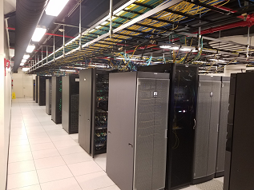
Data Center Quick Info
Rack mountable equipment
Specific, measurable, known
Extensive redundancy
Redundant power, cooling, networks, other devices
Power Distribution Units (PDU’s)
Can monitor power draw (amperage)
Some are network accessible
Raised floor design
Power feeds under floor
Cooling through floor
Overhead cable trays
Storage networks or TCP/IP networks

Slide 22
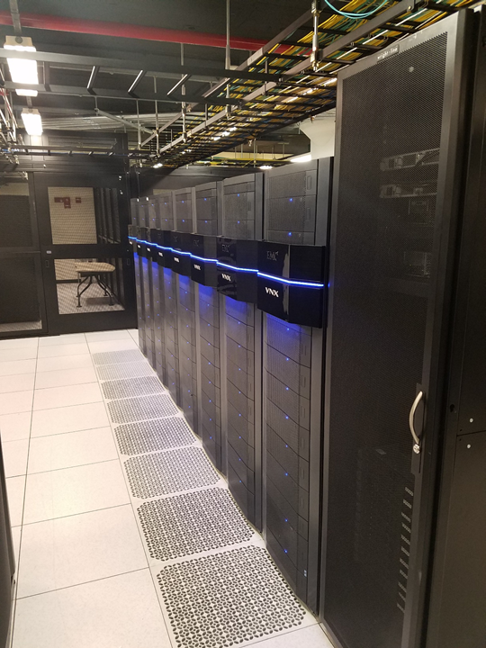

Slide 23
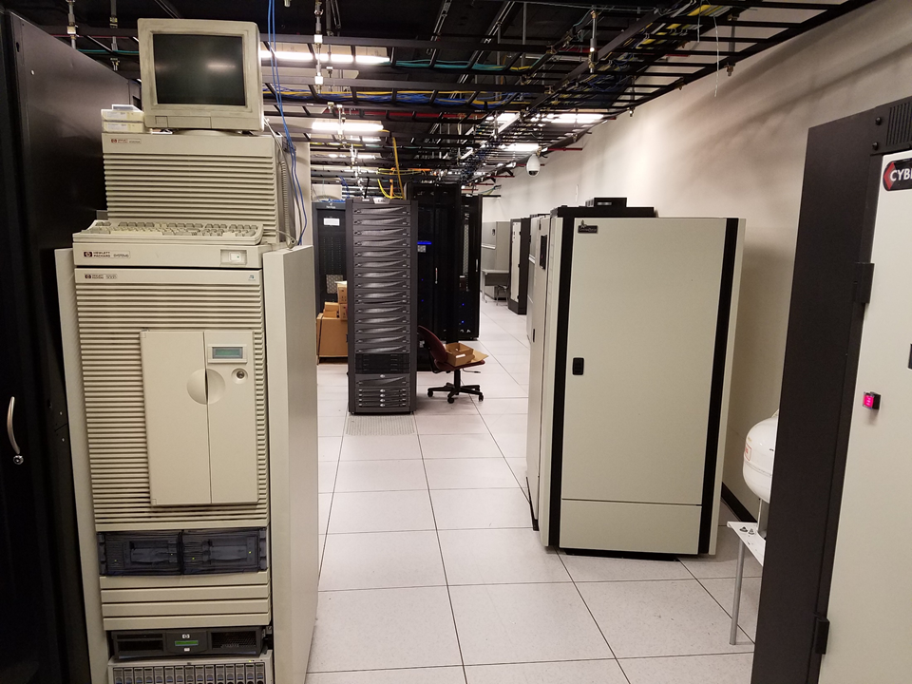

Slide 24
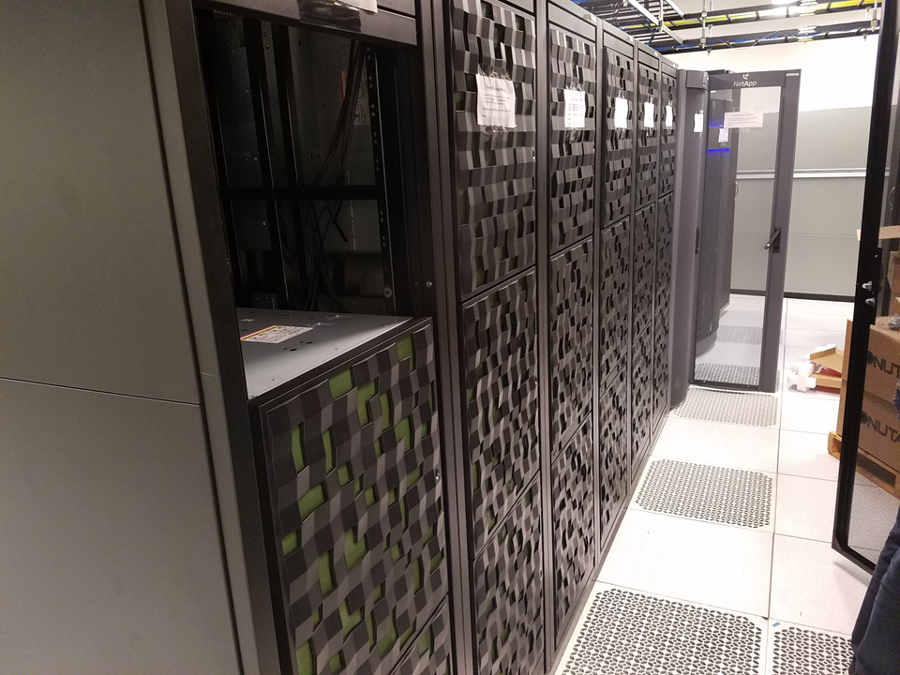

Slide 25
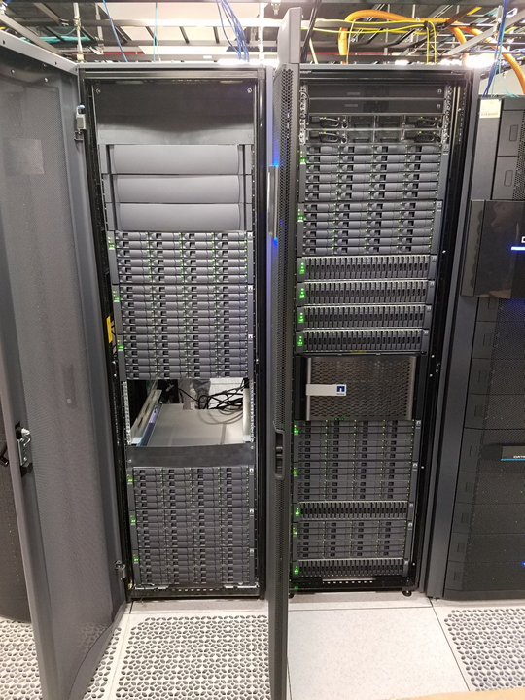

Slide 26
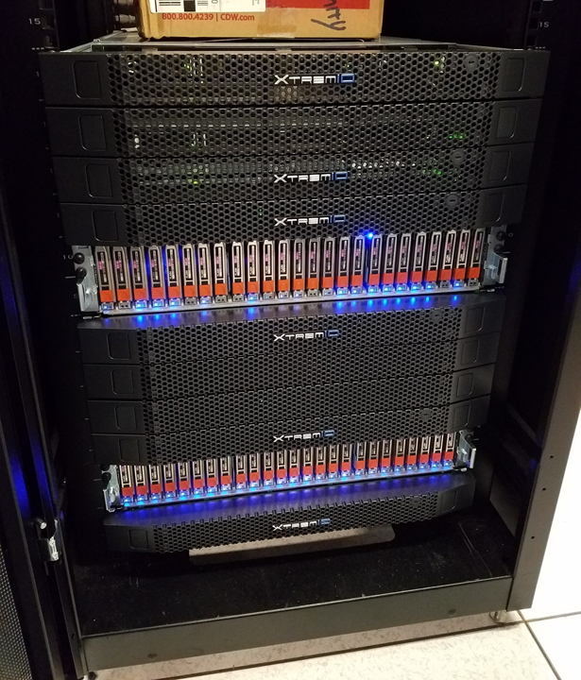

Slide 27
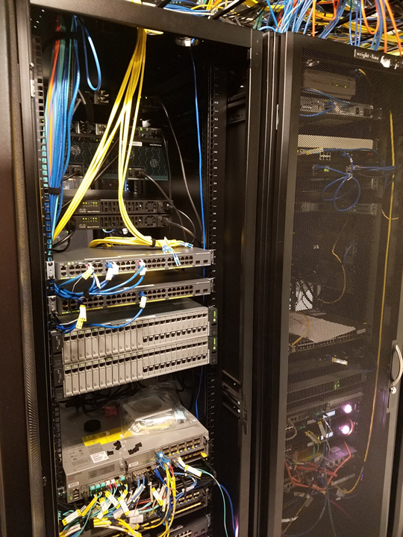

Slide 28
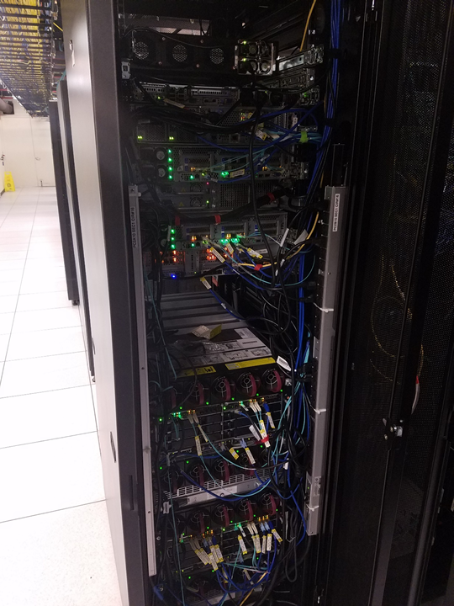

Slide 29
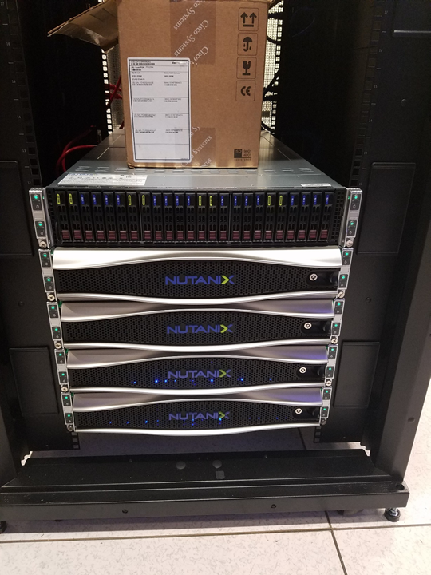

Slide 30
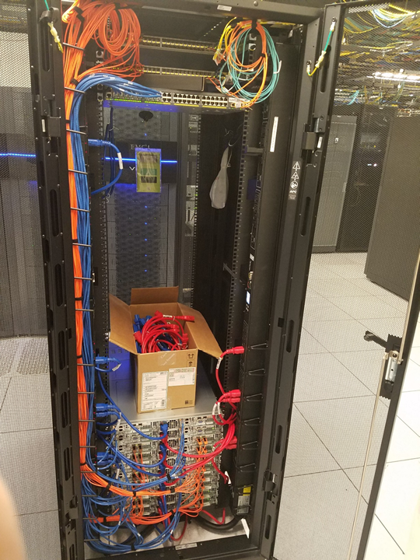

Slide 31
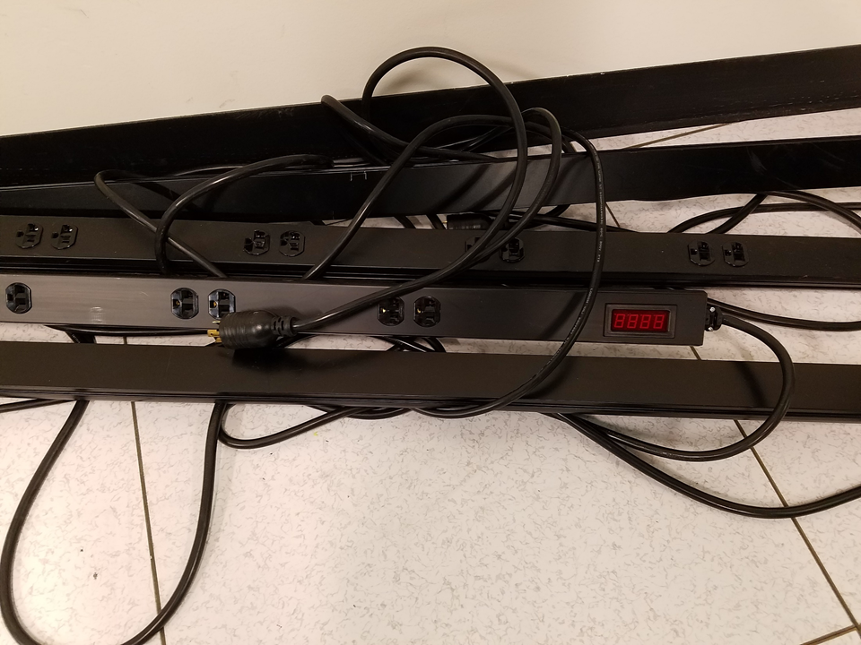

Slide 32
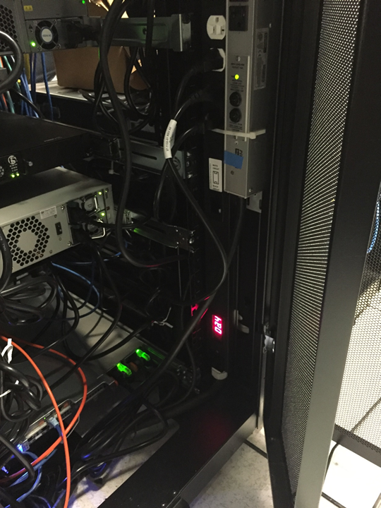

Slide 33
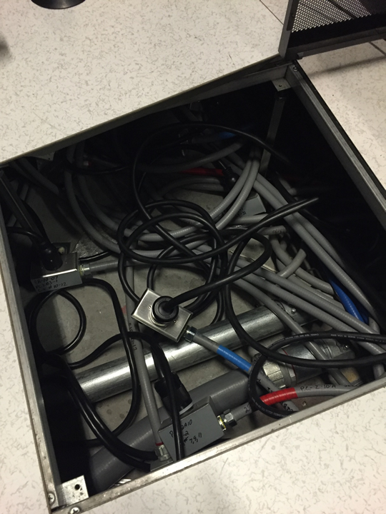

Slide 34
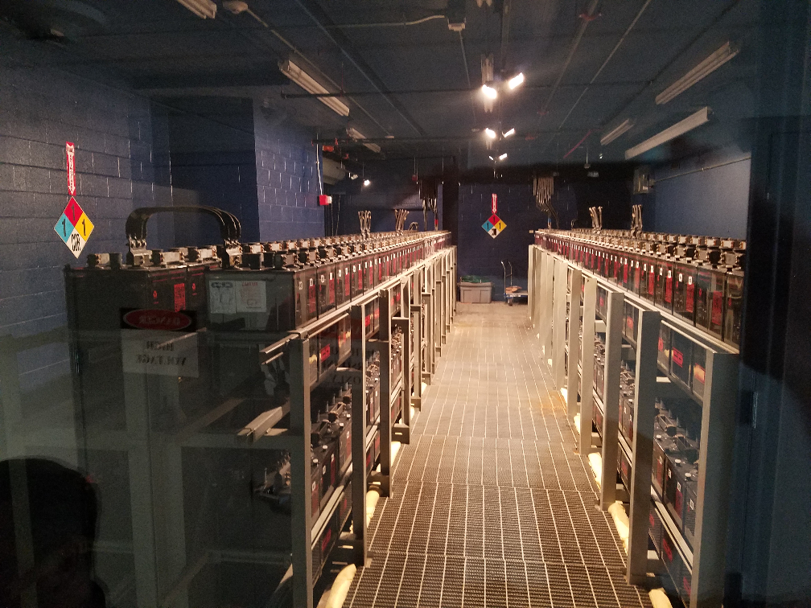

Slide 35
Data Center Quick Info
Data Storage Frames!
Tons of hard drives providing raw storage
Controller PC manages devices
RAID
Highly Available
Ultra Fast Fiber Channel Connectivity
Horizontal drives = Traditional Spinning Hard Disk Drive (HDD)
Vertical drives = Solid State Storage (SSD)

Slide 36
Data Center Quick Info
Under the floor!
Power and air handling
Cold air is pumped into the floor
Grated floor tiles allow cool air up in the proper places
Two different power feeds
Red power feed – “Side A”
Blue power feed – “Side B”
Make sure to follow power separation into cabinets!
Its pointless to have separate power feeds if you don’t use them appropriately!
May be separate feeds from two different utility providers, or separate feeds from the same utility provider

Slide 37
Data Center Quick Info
Battery Backup Power!
Banks of lead-acid batteries
These batteries give off toxic fumes…
There is an exhaust fan in the back corner of the room
There is also a temperature control unit back there
Wired together to provide the correct voltage/amperage
Series vs. parallel wiring
Batteries provide instant power, preventing interruptions when utility power is lost
Battery backup is only intended for a short time (< 1 hour)
A generator is intended to provide extended power supply during a utility power outage
Area for improvement? New battery technology?

Slide 38
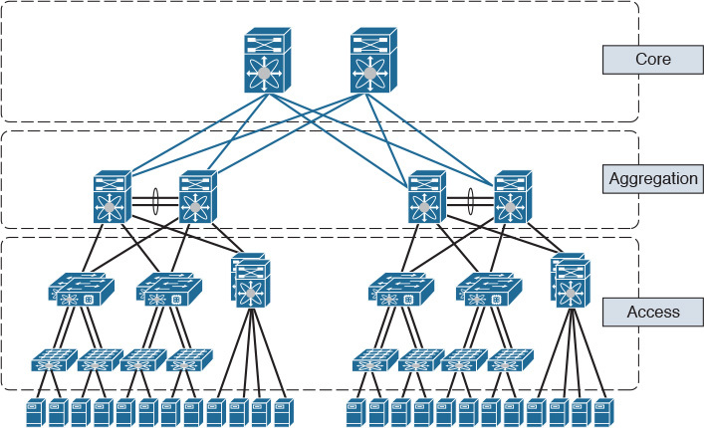
Data Center Infrastructure
Storage
Physical Disk Storage
Local server storage
Storage Area Network (SAN)
Network Attached Storage (NAS)
Networking
Three-Tier Design
Core Switches
Aggregation or Distrubution Switches
Access or Top of Rack Switches (multiple layers)
Compute
Various form factors
Rack mount, blades, desktop chassis
RAM/CPU/Motherboard – Sometimes storage

Slide 39
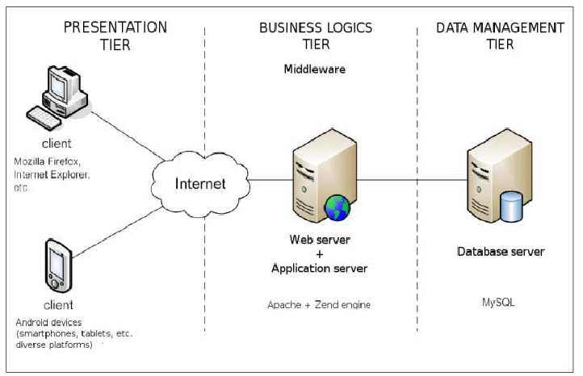
3-Tier Architecture
A Client-Server software architecture pattern
Clients interact with the presentation tier
Also called the client tier
Web browser, mobile device interface, or others (fat client)
Logic Tier coordinates the application and commands
Programming and website logic
Website server
Data tier stores and organizes data
Databases
SQL commands and similar
Middleware may be in place connecting between layers

Slide 40
Hyper-Converged Infrastructure
Virtualizes the aspects of a conventional hardware defined data center system
Virtualized computing (VM’s), Virtual SAN, Virtual Networking
Often times run on commodity (off the shelf) hardware
Decreased costs, can be easier to obtain, can be a lesser quality…
Software defined IT Infrastructure
Virtualize everything, script everything, automate everything
Easily repeatable, easily auditable, easily maintained
How far can you virtualize?
How much can you automate?
Leads to different data center methodology!
Standardize hardware components
Virtualize everything
Script the entire deployment of your infrastructure
Then automate your middleware and app deployments!

Slide 41
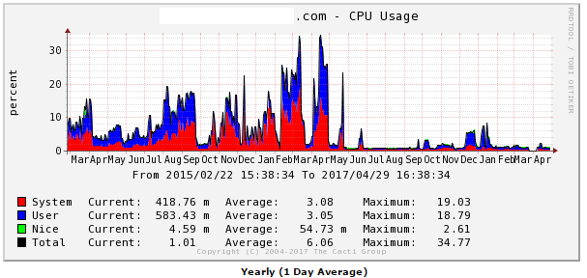
Monitoring Operating Systems
Splunk
Log file aggregation tool - Organize many different log files into a single searchable interface
Multiple logs from multiple systems!
Correlate information between different logs/systems/etc.
Cacti
Monitor network, CPU, disk space, etc.
Long-term system monitoring
Example graph to right →
Naigos
Similar to Cacti
Monitor system resources
Netdata
Real-time short-term system monitoring
Nimbus

Slide 42
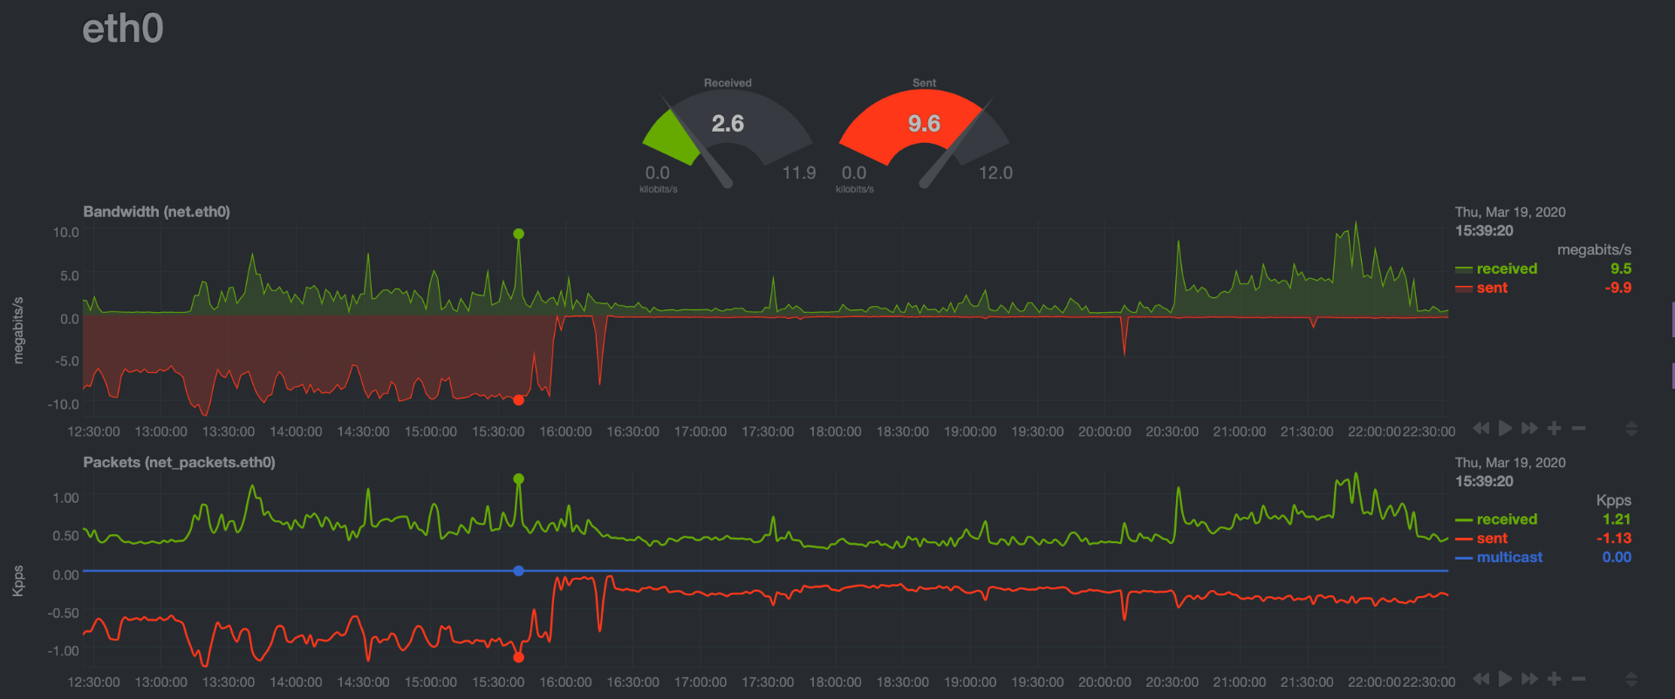
System Analysis and Troubleshooting
Upon a random look at graphs on my system, I notice the following…
Outbound traffic on eth0 is pretty high! Approx 9.6 MBps outbound constantly…
Eth0 is the WAN (internet) interface
Is this normal usage?
Lets take a look at our historical graph…

Slide 43
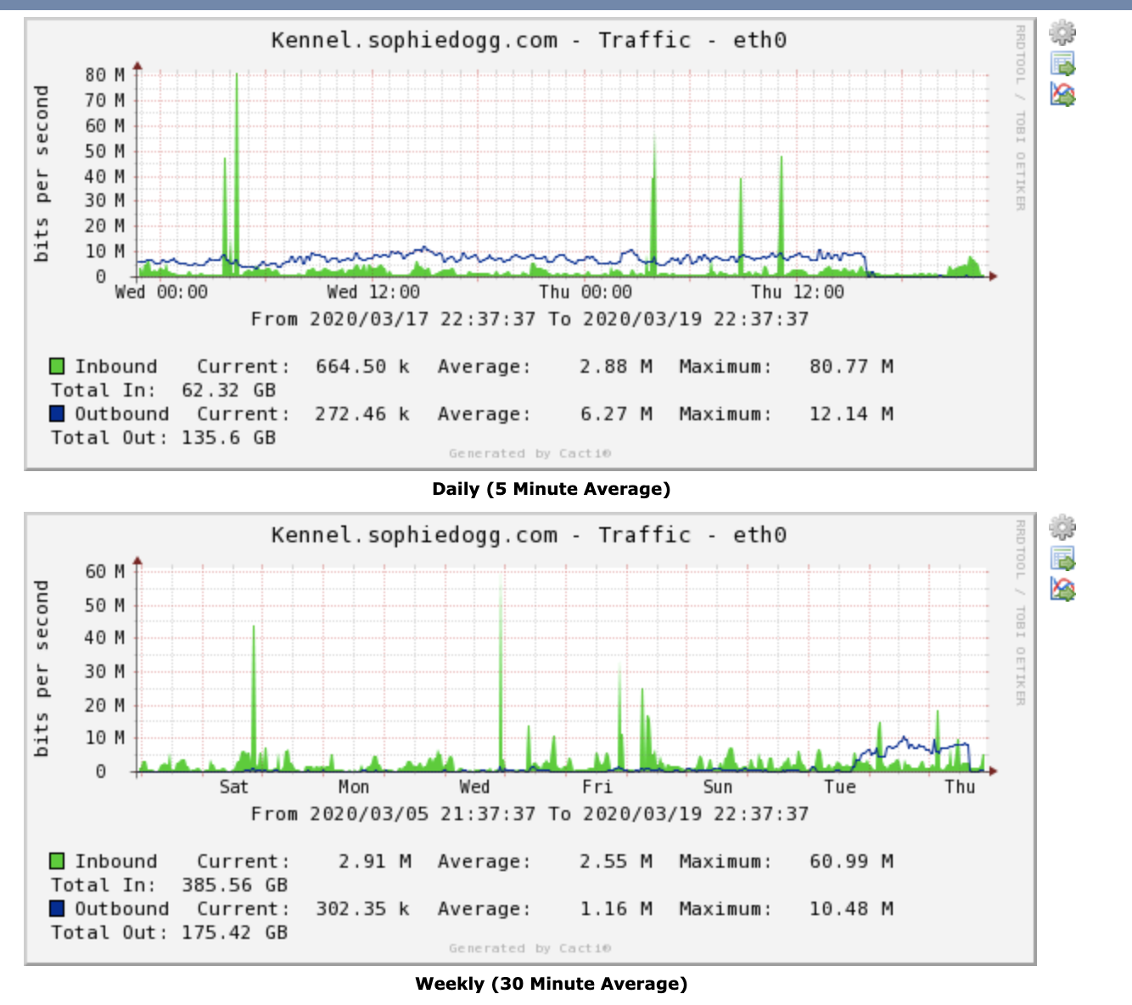
System Analysis and Troubleshooting
Upon a random look at graphs on my system, I notice the following…
Outbound traffic on eth0 is pretty high!
Eth0 is the WAN (internet) interface
Is this normal usage?
Lets take a look at our historical graph…
That looks like it has been sending data for almost a day…
Probably not normal
Let’s investigate further…

Slide 44
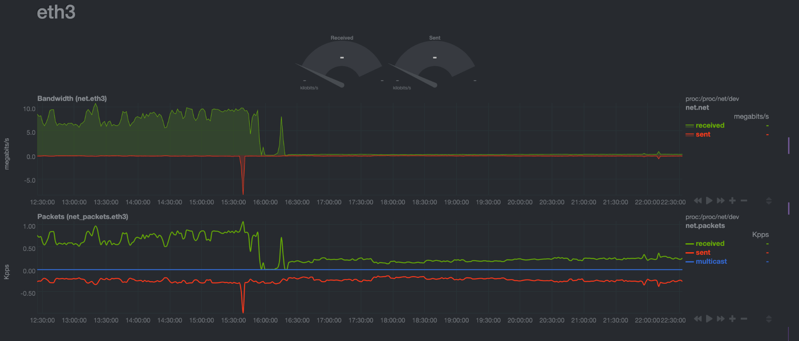
System Analysis and Troubleshooting
Upon a random look at graphs on my system, I notice the following…
Outbound traffic on eth0 is pretty high!
Eth0 is the WAN (internet) interface
Is this normal usage?
Lets take a look at our historical graph…
That looks like it has been sending data for almost a day…
Probably not normal
Let’s investigate further…
Well, that’s a similiar pattern on eth3 (NAS)…

Slide 45
System Analysis and Troubleshooting
Upon a random look at graphs on my system, I notice the following…
Outbound traffic on eth0 is pretty high!
Eth0 is the WAN (internet) interface
Is this normal usage?
Lets take a look at our historical graph…
That looks like it has been sending data for almost a day…
Probably not normal
Let’s investigate further…
Well, that’s a similiar pattern on eth3 (NAS)…
Gotta go read logs…

Slide 46
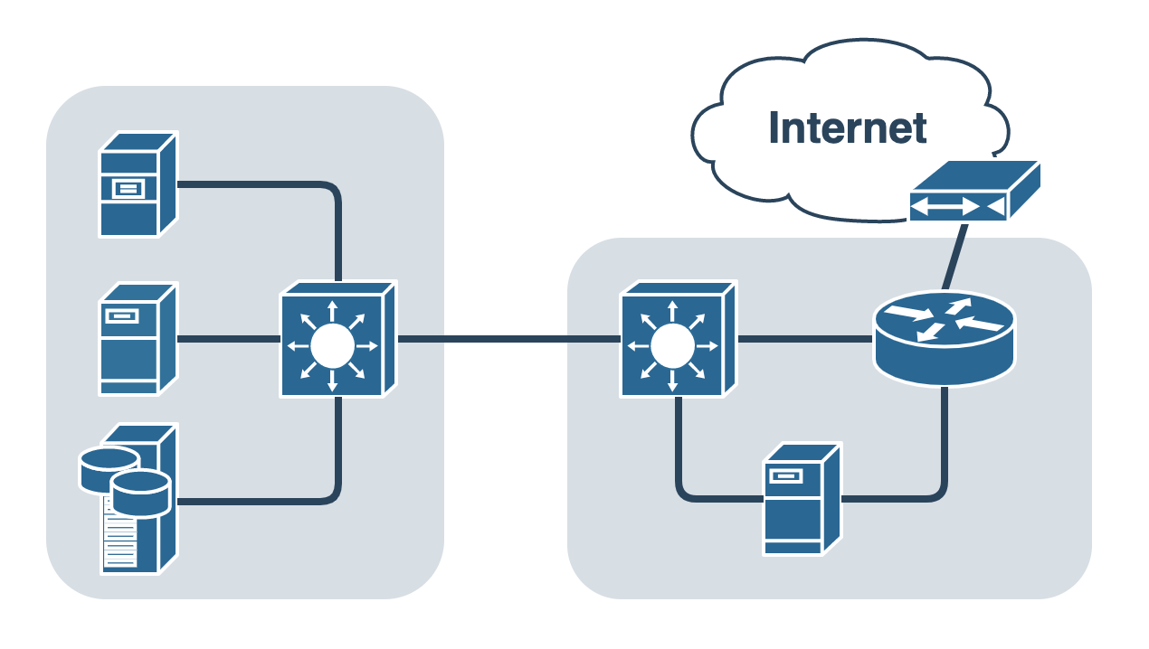
System Analysis and Troubleshooting
Two physical devices
Physical Server
VM Host
SSH Server
VPN Server
File Server
Lots of disks and network cards
DNS, DHCP, NTP, more…
NAS
5 x 10TB disks
Raid 5 array, 1 hot spare
27TB available, 9TB in use
VM Host
Put services in separate VMs!
DNS, DHCP, NTP, more…
DS1019+ NAS
Physical Server

Slide 47
System Analysis and Troubleshooting
Turns out this was a DNS redirection DDOS attack!
I had recently moved my DNS services to a new VM running on my NAS device (on eth3)
I previously would forward all DNS requests to my new internal DNS server
This DNS server performed authoritative responses for my personal subdomains
This DNS server also performed non-authoritative recursive DNS resolution for clients on my local network
The forwarding rules I put in place for DNS forwarding to the internal VM perform IP Masquerading (NAT) on incoming addresses
To my internal DNS server, the forwarded requests from the internet appear to come from the router’s local IP address!
Can you guess what happens next?!
DS1019+ NAS
Physical Server

Slide 48
System Analysis and Troubleshooting
Turns out this was a DNS redirection DDOS attack!
I had recently moved my DNS services to a new VM running on my NAS device (on eth3)
I previously would forward all DNS requests to my new internal DNS server
This DNS server performed authoritative responses for my personal subdomains
This DNS server also performed non-authoritative recursive DNS resolution for clients on my local network
The forwarding rules I put in place for DNS forwarding to the internal VM perform IP Masquerading (NAT) on incoming addresses
To my internal DNS server, the forwarded requests from the internet appear to come from the router’s local IP address!
My private internal server became an open DNS resolver!
https://www.cloudflare.com/learning/ddos/dns-amplification-ddos-attack/

Slide 49
IPTables Examples - WWW
Allow any TCP packets coming in on port 80
iptables -A INPUT -p tcp --dport 80 -j ACCEPT
Restrict TCP traffic coming in on port 80 to unprivileged source ports
iptables -A INPUT -p tcp --dport 80 --sport 1024:65535 -j ACCEPT
Restrict inbound port 80 TCP traffic to specific IP and network interface
iptables -A INPUT -i eth0 -p tcp -d 192.168.1.10 --sport 1024:65535 --dport 80 -j ACCEPT
Allow outbound traffic to TCP port 80 from our server
iptables -A OUTPUT -p tcp --dport 80 -j ACCEPT
Allow outbound traffic to UDP port 443 from our server
iptables -A OUTPUT -p udp --dport 443 -j ACCEPT

Slide 50
IPTables Examples - SSH
SSH uses port TCP 22
Input rules for SSH Servers:
iptables -A INPUT -p tcp --dport 22 -j ACCEPT
Output rules for SSH Connections:
iptables -A OUTPUT -p tcp --dport 22 -j ACCEPT
Rules can potentially be more complex/restrictive
iptables -A OUTPUT -o eth0 -p tcp -s 192.186.0.1 --dport 22 --sport 1024:65535 -j ACCEPT

Slide 51
IPTables Example – Filter Table/Input Chain
*filter
:INPUT DROP [0:0]
:FORWARD DROP [0:0]
:OUTPUT ACCEPT [1:71]
-A INPUT -m state --state RELATED,ESTABLISHED -j ACCEPT
-A INPUT -i lo -j ACCEPT
-A INPUT -i br0 -p udp -m udp --dport 67 -j ACCEPT
-A INPUT -s 66.220.2.74/32 -i eth0 -p icmp -m icmp --icmp-type 8 -m limit --limit 1/sec -j ACCEPT
-A INPUT -j fail2ban
-A INPUT -p udp -m udp --dport 53 -j ACCEPT
-A INPUT -p tcp -m tcp -m multiport --dports 53,1194,50505 -j ACCEPT
-A INPUT -s 10.11.187.0/24 -i br0 -p tcp -m tcp -m multiport --dports 19,19999,32400 -j ACCEPT
-A PREROUTING -p udp -m udp --dport 21 -j DNAT --to-destination 10.11.187.31:1194
-A POSTROUTING -s 10.11.186.0/23 -o eth0 -j MASQUERADE
-A POSTROUTING -d 10.11.187.31/32 -p tcp -m tcp --dport 1194 -j SNAT --to-source 10.11.187.1
-A POSTROUTING -d 10.11.187.31/32 -p udp -m udp --dport 1194 -j SNAT --to-source 10.11.187.1
COMMIT
RHEL6/CentOS6 - /etc/sysconfig/iptables

Slide 52
Firewall Configurations
FirewallD
Front-end controller for iptables, used to implement persistent network traffic rules
Command line and graphical interfaces available
Rules can be added/removed/modified without interfering with current network traffic
firewall-cmd command used to modify firewall rules
firewall-cmd --get-default-zone
What zone is currently being used by default
Different zones can be applied to different interfaces
firewall-cmd --get-active-zones
What zones are currently active on what interfaces
firewall-cmd --zone=public --list-all
What rules are currently configured in the firewall

Slide 53
Firewall Configurations
FirewallD
Front-end controller for iptables, used to implement persistent network traffic rules
Command line and graphical interfaces available
firewall-cmd command used to modify firewall rules
firewall-cmd --zone=public --add-service=http
Allow http traffic to the runtime configuration
firewall-cmd --zone=public --add-service=http --permanent
Allow http traffic to the permanent configuration
firewall-cmd --zone=public --add-port=8080/tcp
firewall-cmd --zone=public --add-port=8080/tcp --permanent
Allow traffic to TCP port 8080 from any host, runtime and permanent configs
Rich Rules can be created for more advanced traffic control
firewall-cmd --zone=public --add-rich-rule 'rule family="ipv4" source address="192.168.0.0/24" port port=12345 protocol=udp accept' --permanent
The above command is all one line…

Slide 54
Firewall Configurations
FirewallD Configuration
Start firewalld service and enable on boot
systemctl start firewalld
systemctl enable firewalld
Check our default and active zones and list all rules in our active zone
firewall-cmd --get-default-zone
firewall-cmd --get-active-zones
firewall-cmd --zone=public --list-all
Add the http and https services to our firewall to allow traffic
If we try to connect to our websites right now, all web traffic should be blocked!
firewall-cmd --zone=public --add-service=http
firewall-cmd --zone=public --add-service=http --permanent
firewall-cmd --zone=public --add-service=https
firewall-cmd --zone=public --add-service=https --permanent

Slide 55
Firewall Configurations
FirewallD Configuration
Add SSH if necessary
firewall-cmd --zone=public --add-service=ssh
firewall-cmd --zone=public --add-service=ssh --permanent
Should already be enabled
Add a custom rule, allowing TCP traffic on port 55555 from CS subnet
firewall-cmd --zone=public --add-rich-rule 'rule family="ipv4" source address="147.64.242.0/23" port port=55555 protocol=tcp accept'
firewall-cmd --zone=public --add-rich-rule 'rule family="ipv4" source address="147.64.242.0/23" port port=55555 protocol=tcp accept' --permanent
There are two commands listed above (each command is on two lines)
We could also replace accept with reject, to explicitly reject the traffic!
Add another rule, using this easier syntax, allowing all sources.
firewall-cmd --zone=public --add-port=43234/udp
firewall-cmd --zone=public --add-port=43234/udp --permanent

Slide 56
Firewall Configurations
FirewallD Configuration
Explicitly REJECT the following traffic
Perhaps we want to intentionally reject something (speed up timeouts maybe?)
firewall-cmd --zone=public --add-rich-rule 'rule family="ipv4" source address="147.64.242.0/23" port port=32123 protocol=tcp reject'
Change our default response to DROP!
By default, our firewall will respond with a “Blocked” response. We want it to just completely ignore it instead!
firewall-cmd --zone=public --set-target=DROP --permanent
Reload our firewall to apply any unapplied configurations, and list what is enabled in our public zone:
firewall-cmd --reload
firewall-cmd --zone=public --list-all
Check out what is happening in all of the zones
firewall-cmd --list-all-zones

Slide 57
Web Browser SOCKS Proxy Config
Firefox Example
Extremely easy to set, others more difficult
Open SSH tunnel with dynamic port forwarding to cslab100 using your cslab account
Ex: ssh –D 55555 jpatalon@cslab100.cs.edinboro.edu
You can also create a shortcut in windows, append to the end:
Ex: putty.exe –D 55555 jpatalon@cslab100.cs.edinboro.edu
Download putty, and create a shortcut on your desktop
Log in to your account with your password
Launch Firefox

Slide 58
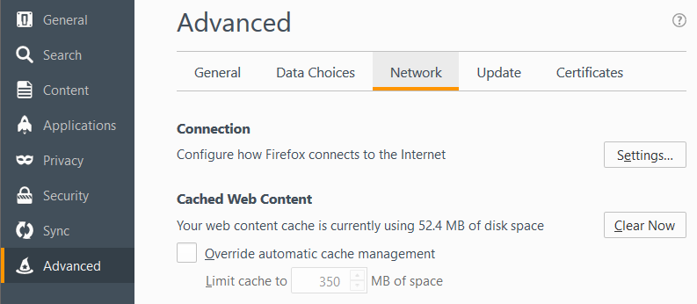
Web Browser SOCKS Proxy Config
Exact steps may differ depending on version
Options
Advanced
Network Tab
Settings…
Older Firefox version…

Slide 59
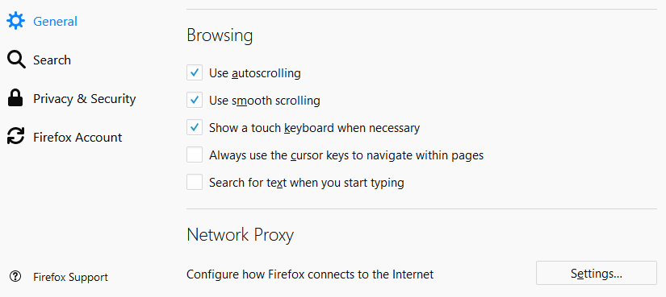
Web Browser SOCKS Proxy Config
Exact steps may differ depending on version
Options
General
Network Proxy
All the way at the bottom
Settings…
Firefox v59.0.1

Slide 60
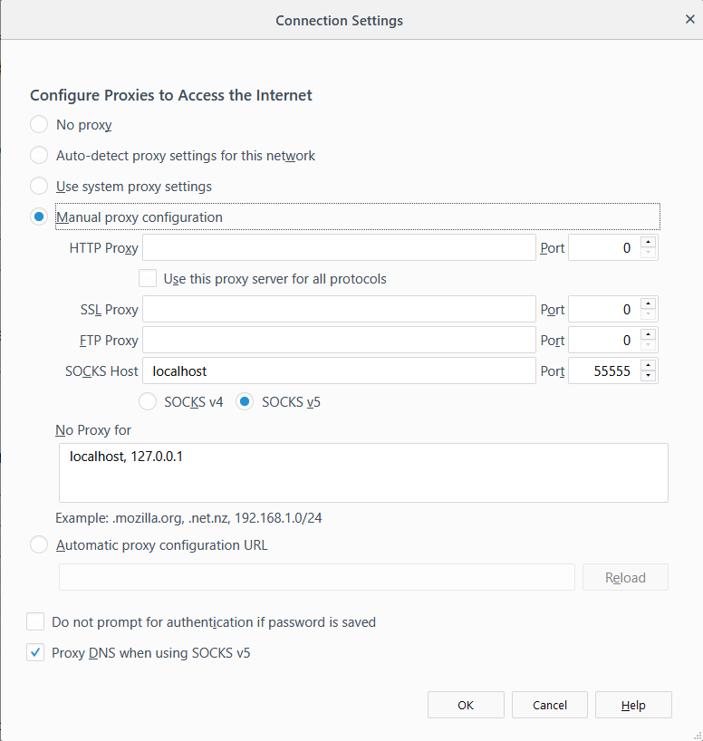
Web Browser SOCKS Proxy Config
Exact steps may differ depending on version
Options
Advanced
Network Tab
Settings…
Manual Proxy Configuration
SOCKS Host: localhost
Port: 55555
SOCKS v5
No proxy for:
localhost, 127.0.0.1
Proxy DNS when using SOCKS v5

Slide 61
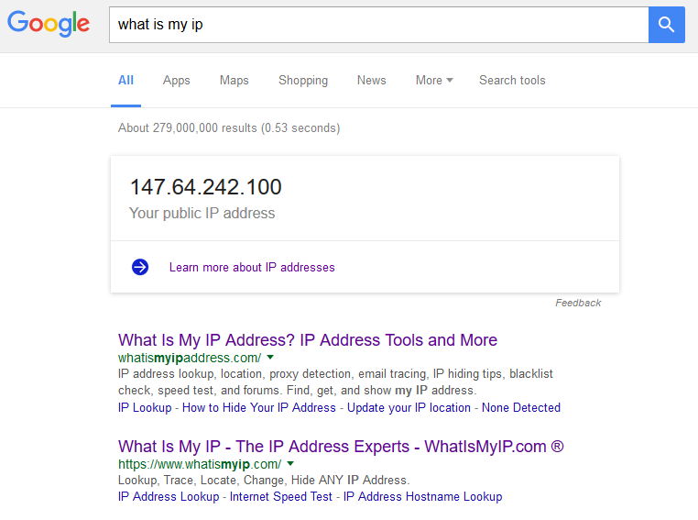
Web Browser SOCKS Proxy Config
Test by opening a web page, and visit a website that will tell you your IP
http://whatismyip.com
Type in to google “What is my ip”
Multiple servers with multiple ports
Open multiple connections on different ports
Switch ports to quickly switch proxy endpoint
Compare to same search in a different browser that is not configured for proxying
Firefox should give a different result than Chrome or Interner Explorer, since Firefox is configured to use the SSH SOCKS proxy and the other web browsers are not.
You may have to specifically check for your IPv4 address!

Slide 62
ECSC 325.200 Web Server Administration
Spring 2025 - Week 12-2 – April 3rd, 2025
Stuff and Things…
Prof. Jason Patalon

Slide 63
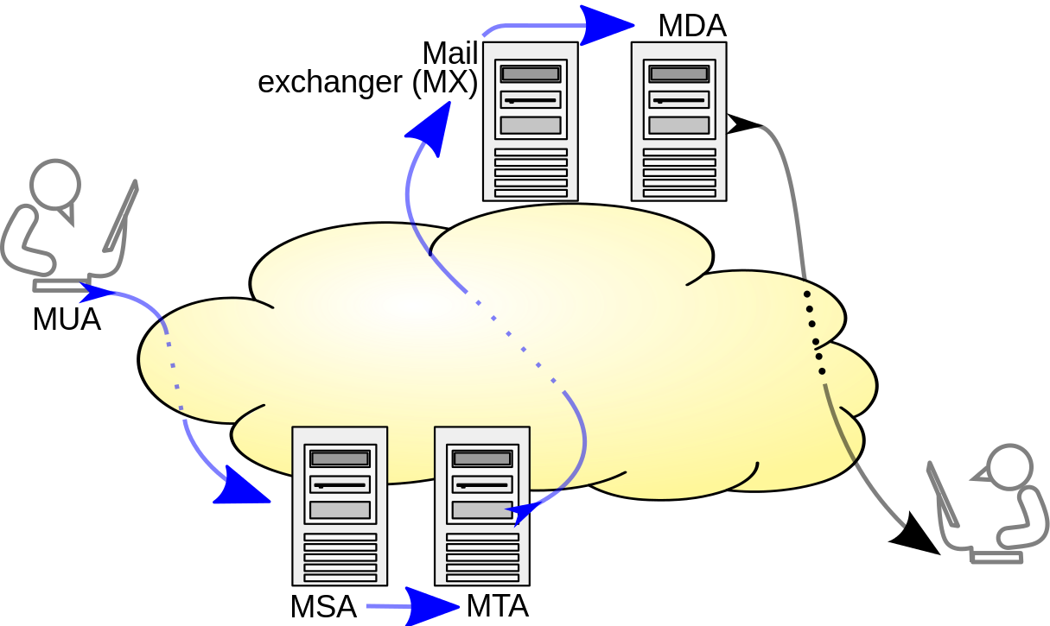
E-Mail System Terminology
MTA – Mail Transfer Agent
Accepts E-Mail from clients and sends to another MTA for delivery
Indicated my MX DNS records
Sendmail, Postfix
MSA – Mail Submission Agent
Provides address resolution services
Determines appropriate server to send email to for specified email address
Looks up MX records for a domain
MDA – Mail Delivery Agent
Delivers E-Mail from server to MUA (inbox)
Integrated with Sendmail, Postfix
MUA – Mail User Agent
E-Mail client
Outlook, pine, Gmail, SquirrelMail
Multiple functions
can be combined!
Notes:
By Ale2006-from-en - Own work, CC BY-SA 3.0, https://commons.wikimedia.org/w/index.php?curid=10583999
Blue arrows indicate SMTP

Slide 64
E-Mail Protocols
Simple Mail Transfer Protocol (SMTP)
Used to send E-Mail messages from one server to another
Post Office Protocol 3 (POP3)
Used to retrieve E-Mail from a server
Traditionally all messages are downloaded to the client and removed from the server
New POP3 implementations will allow downloaded messages to remain on server
Internet Message Access Protocol (IMAP4)
Used to retrieve E-Mail from a server
E-Mail messages will remain on server
Local copies can be cached on the client
Server can be configured with folders for organization

Slide 65
E-Mail Protocols
E-Mail access works in one of three modes
Online Mode
Having direct file-system level access to the mail store
Read access to /var/mail or similar
Offline Mode
Client is assumed to be disconnected, except when pulling mail
POP3 protocol method of operation
Disconnected Mode
Changes made on the client while disconnected are queued until reconnection and mail received on the server is stored until next connection
Changes made on the client while connected are immediately synchronized with the server and mail received on the server is immediately synchronized to the client
IMAP4 supports all three modes of operation
Dovecot – IMAP/POP3 Server
Postfix – SMTP Server

Slide 66
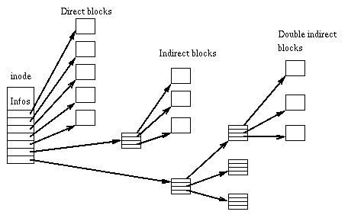
File Systems
I-Nodes – A control structure that points to data blocks or other i-nodes
Fundamental building block of many file systems
Limits on number of i-nodes
Blocks – A sequence of bytes on a media
The smallest addressable storage unit
A file can be saved across one or more blocks
Large block sizes can waste disk space
Grouped in to Block Groups
Superblocks – The first piece of info on a disk
Contains key disk information
Disk geometry, available space, first i-node location
Multiple copies of the superblock, kept within each block group

Slide 67
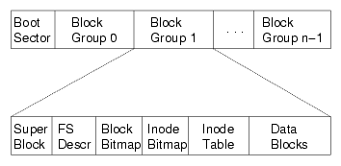
File Systems
File System – Provides a means of organizing data on a storage medium
Abstraction layer above physical sectors, cylinders, circuits, etc.
Extended File System 3 (EXT3)
Widely used file system
Journaling
Extended File System 4 (EXT4)
Enhancements to EXT3
Extents can describe a group of blocks, instead of each block
Online defragmentation
Larger file systems and file sizes
XFS
Standard on RHEL7/CentOS7 Servers
Btrfs (B-Tree FS)
Butter FS
NTFS, FAT32, more…
Notes:
Journaling file systems create an entry in a journal, before making a change to a disk, allowing for the ability to validate tasks were completed

Slide 68
File Systems
File system manipulation
Mount and unmount file systems with the mount and umount commands
Edit file system mounting properties in the /etc/fstab file
Specifies disk path, mount point, mount options, etc.
List open files with the lsof command
Find files open on a filesystem by piping the output from lsof to grep and searching for desired location
Ex: lsof | grep /home
Check a filesystem with the fsck tool
Doesn’t work on XFS! Use xfs_repair to replay journal (automatic on mount)
The Lost+Found directory contains lost files…
File fragments, directories, special files
Lost i-node links or missing extent descriptions
Unique per file system
In general, if you have data here, you have data loss.

Slide 69
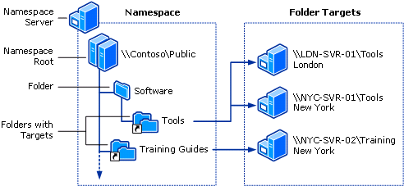
Distributed File Systems (DFS)
A Distributed File System makes it possible to create a single directory tree that links together multiple file servers and their files
Provides a common view of a centralized file system that is distributed among various servers
Even though files are stored on different servers, to the user they appear on the same server
Allows for replication among DFS servers
Allows for the movement of files physical storage location without affecting any user or application usage
System can be reconfigured as needed to alleviate performance issues
System can be easily expanded if necessary, without any impact to existing users

Slide 70
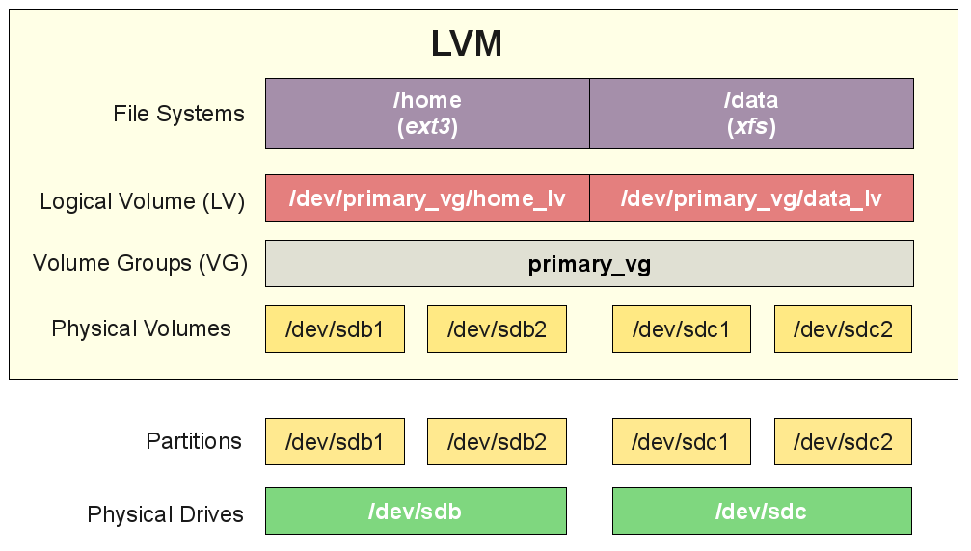
File Systems
Typical Linux Volume Management – Logical Volume Management (LVM)
Disks are partitioned into physical volumes
Each disk can be split into one or more partitions
Each partition can be made in to a physical volume
fdisk creates partitions, pvcreate to create physical volumes
Physical volumes are grouped into volume groups
Multiple volumes grouped together into one large storage group
New volumes can be added to volume groups on the fly
Volume groups created with vgcreate
Volume groups are divided into logical volumes
Logical volumes can stripe across multiple physical volumes, increasing throughput across multiple disks
Logical volumes can be grown without service interruption
Logical volumes created with lvcreate
Logical volumes can be formatted to file systems
mkfs command (ext2/3/4, xfs, btrfs, etc.)

Slide 71
Threats and Vulnerabilities
Hacker
Someone who seeks and exploits weaknesses in a computer system or computer network.
May be motivated by profit, protest, challenge, enjoyment, or employment.
Various types of hackers
Black/white/grey hat
Elite
Script Kiddie
Cracker
Someone who uses cracking software to recover passwords or modify programs
Crack various types of security on PC games
Attacker
Generic term for anyone involved in nefarious activity

Slide 72
Threats and Vulnerabilities
Attacks can come from various locations/vectors
Network Attacks
Interrupt network services, preventing users from transmitting data
Intercept insecure network traffic
Alter traffic flow to sites
Operating System Attacks
Exploit vulnerabilities in the operating system itself
Software Attacks
Exploit specific software, may cross multiple platforms
Social Engineering
Manipulate people to divulge information
Some people are gullible, easy to trick
Phishing, diversion, pretexting, baiting, quid pro quo
Humans are typically the weak part of any system…

Slide 73
Network Security
TCP/IP networks originally designed for communication, not security!
Hackers can take advantage of communication standards
Information can be intercepted, altered, and passed on to clients
Packet headers often targeted
Source address
Destination address
Packet ID, flags, offset
Length
Protocol information

Slide 74
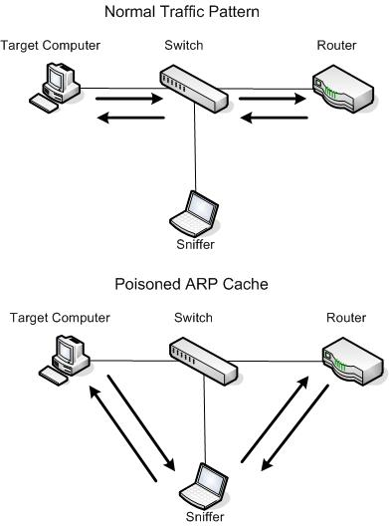
Network Security
ARP Spoofing – Man in the Middle attack
ARP Cache Poisoning
ARP associates IP addresses and MAC addresses on a layer 2 (switched) network
Must be on the same network subnet as the target/victim
Devices using ARP are inherently insecure
They will accept updates at any time, no security checks
Impersonate the network gateway device
Victim passes all traffic through you, you then forward to gateway
Gateway forwards all traffic for victim through you
You intercept all data communications between target and gateway
You can now easily inspect any unencrypted packets

Slide 75
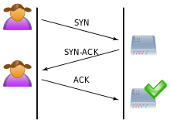
Network Security
TCP Three-Way Handshake
Typical network connection
User sends SYN request to server, requesting a connection
Server responds with SYN-ACK, acknowledging the connection request
Client responds with ACK, acknowledging the request and establishing the connection

Slide 76
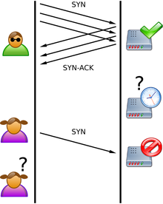
Network Security
SYN Flood
A type of Denial of Service (DoS) attack
Attacker sends multiple SYN requests to server, pretending to request a number of connections
Requests may be forged, directing replies to various unsuspecting locations
Reflected or spoofed attack
Requests may come from different sources, making the attack distributed
Server responds with multiple SYN-ACK’s, acknowledging the number of connection requests
Acknowledgements are never returned, leaving the connections in a half-open state, preventing new connections from occurring
Legitimate clients are unable to make connections, since all available connections are stuck in a half-open state
Various countermeasures can be used

Slide 77
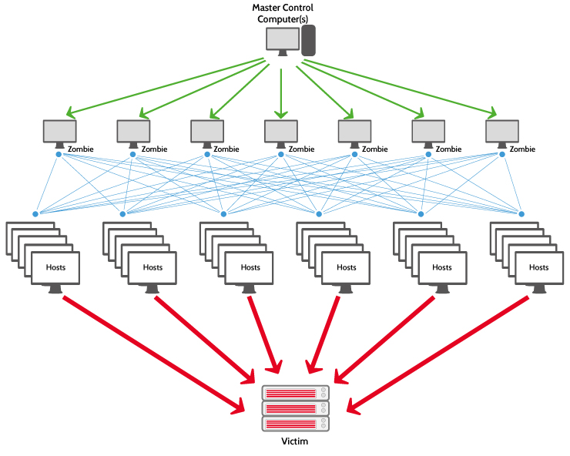
Network Security
Denial of Service Attack (DoS)
Attempt to make resource unavailable due to overwhelming concurrent connections
Using multiple sources creates a distributed denial of service attack (DDoS)
Symptoms include slow or unavailable network resources
Incorrectly configured network equipment can propagate certain types of attacks
Attacks may be designed to crash services or overwhelm (flood) services
Most involve IP address spoofing, disguising the actual source locations
Notes:
Mirai (Japanese for "the future", 未来) is malware that turns networked devices running out of date versions of Linux into remotely controlled "bots", that can be used as part of a botnet in large-scale network attacks. It primarily targets online consumer devices such as remote cameras and home routers. - Wikipedia

Slide 78
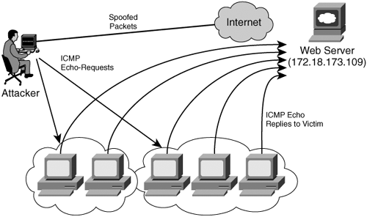
Network Security
Amplification and Reflection Attacks
Use a small amount of traffic to create a larger response
Attacker spoofs source address, perform relatively small network bandwidth sized action
Response from affected systems are directed to spoofed source address (target)
Bandwidth used by response is larger than initial query
Source of attack is “reflected” off of responding server
NTP, DNS, CharGen
Teardrop attacks
Can crash various operating systems
Attacks flaw in underlying TCP/IP code
Caller ID Spoofing

Slide 79
Network Security
Internet Control Message Protocol (ICMP) flood
Also called smurf attack
Uses incorrectly configured network devices to broadcast packets across the network
Spoofed source address causes all traffic to incorrectly respond to target
Ping flood
Overwhelm user with more ping request traffic than they can handle
Simple attack, only requiring more network bandwidth than the target
Ping of Death, Nuke
Crash system with malformed packets

Slide 80
Network Security
Advanced Persistent DoS (APDoS)
Large scale attacks using commercial equipment
Can simultaneously use multiple coordinated attack vectors
HTTP floods, injection attacks, syn floods, etc
Can affect multiple layers
Interfering with the associated networking equipment can affect other uses of that equipment
Typically explicit motivitation
Nation-State warfare
Large financial gain

Slide 81
Nmap – The Network Mapper
Features
Scan IP address ranges
Scan and ID port ranges
Perform OS fingerprinting
Scriptable interactions with target (NSE)
Organization Unique Identifier Information (OUI)
Use Cases
Network auditing
Inventory mapping
Network response analysis
Identifying and abusing exploits
Connection and communication testing

Slide 82
Nmap – The Network Mapper
Install Nmap
dnf install nmap -y
Do some sample scans
nmap 147.64.32.6
Perform a basic/default scan on commonly used ports
nmap -sn 147.64.242.100
Perform a ping scan (no port scan) – used to identify if a host responds
Can be customized to use traceroute or Nmap Scripting Engine (NSE)
nmap -p 1-1024 147.64.242.101
Scan TCP ports 1-1024
nmap -O 147.64.32.242
Perform OS fingerprinting; try to determine the guest OS!
Capital oh!
man nmap !

Slide 83
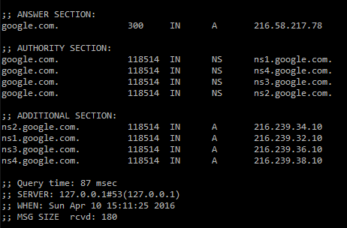
DNS Security
DNS Cache Poisoning
Injecting incorrect DNS data into a servers DNS cache
Causes DNS lookups to return incorrect address
Exploits flaws in DNS software
Provide incorrect authority information
If asked who provides service for a domain, return incorrect info
Redirect nameserver to attackers compromised nameserver
Incorrect NS Records
Provide incorrect additional information
Return incorrect “helper” information
Incorrect “Additional section” in DIG command
Use of Secure DNS (DNSSEC) records to mitigate risks
Cryptographic digital signatures with trusted public key certificates

Slide 84
Operating System Security
OS’s are large and complex pieces of software
Potential for many bugs in such complex software
Opportunity for many different types of vulnerabilities
Unpatched systems can offer easy attack vectors
Patched vulnerabilities are often public
Known attacks may exist against specific unpatched software
Buffer overflows can cause systems to crash
Write data outside of a buffer’s allowed memory
Attacks to specific software
Exploit vulnerabilities in non-OS software
Applications running as root/administrator especially attractive

Slide 85
Web Server Vulnerabilities
PHP/ASP/etc. programming vulnerabilities
Potential for bugs in code that runs server or on clients machine
Web server software vulnerabilities
Opportunity for exploits of Apache/IIS/etc. software
Database attack vulnerabilities
Potential to attack database through incorrect programming
Unencrypted communication
Clear-text passwords
Sensitive information

Slide 86
E-Mail Server Vulnerabilities
Plain text authentication
Spam
Ease of address spoofing
Fake where email appears to come from
Open internet forwarders
Allow for easy anonymous email transmission
DoS Attacks, E-Mail Bombs
Overwhelm email services with illegitimate email messages
Virus
Propagate nefarious applications throughout the world

Slide 87
SMTP Commands and processes
Sample SMTP Session:
[jpatalon@csci325-120 ~]$ telnet spamblock.edinboro.edu 25
Trying 147.64.32.99...
Connected to spamblock.edinboro.edu.
Escape character is '^]'.
220 barracuda.edinboro.edu ESMTP (8908a72cdf255605894d2e1a03ee284e)
HELO megastuff.biz
250 barracuda.edinboro.edu Hello csci325-125. cs.edinboro.edu [147.64.243.125], pleased to meet you
MAIL FROM: <jpatalon@megastuff.biz>
250 Sender <jpatalon@megastuff.biz> OK
RCPT TO: <jpatalon@edinboro.edu>
250 Recipient <jpatalon@edinboro.edu> OK
DATA
354 Start mail input; end with <CRLF>.<CRLF>
From: bob@megastuff.biz
To: junk@edinboro.edu
Subject: test email
This is a test.
.
250 Ok: queued as EFB4511EE001
quit
221 barracuda.edinboro.edu Goodbye csci325-125. cs.edinboro.edu, closing connection

Slide 88
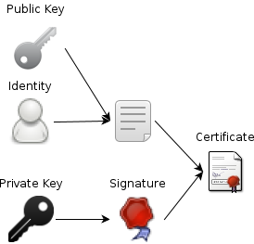
Securing Network Services
Encrypt transmitted data
SSH, SCP, SFTP
HTTPS/SSL
Encrypted WiFi
Establish trusted authorities
Certificate Authorities (CA) verify certificate holders
Create methods of establishing secure connections
Public Key Cryptography
Diffie-Hellman Key Exchange
https://www.youtube.com/watch?v=YEBfamv-_do
8 minutes 37 seconds

Slide 89
Certificate Authority
A Certificate Authority (CA) issues digital certificates
SSL Certificates for use on our websites
Devices (browsers) come with a list of trusted third-party CA’s
Because they are more trustworthy than me…
CA’s certify the ownership of the certificate
CA’s validate the legitimacy of the person or organization
CA’s can also revoke a certificate, if it has been compromised
When we create our own certificates, they are self-signed.
Our browser doesn’t automatically accept it, but we can manually override
We could potentially create our own CA, add it to the trusted list of our servers/clients, and issue our own trusted certificates, to encrypt network traffic

Slide 90
Secure Sockets Layer (SSL)
Digital certificate’s issued by a Certificate Authority (CA)
Identifies an organization
CA most often a third party (e-commerce)
Public Key Infrastructure (PKI)
Defines the system of certificates and authorities
Public key cryptography depends on two keys
Public key
Shared with everyone
Used to encrypt data to sent to a server
Client encrypts session key (clients private key) with message
Private key – kept by owner of the public key
needed to decrypt the data

Slide 91
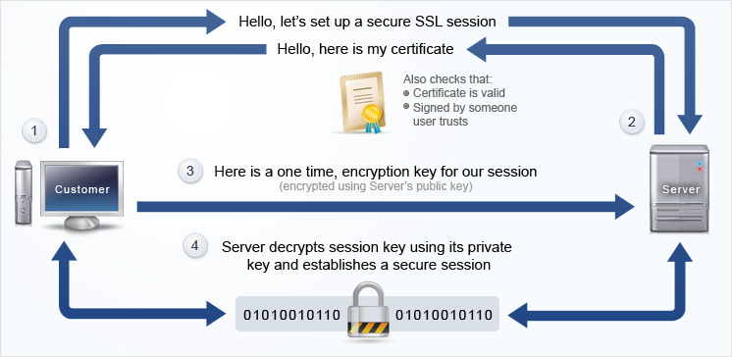
Establish HTTPS Session – Session Key

Slide 92
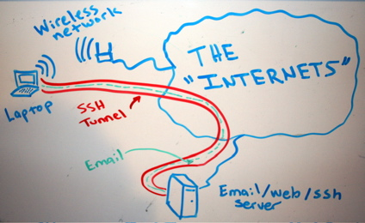
SSH Tunnels
SSH Tunnels are secure and encrypted between endpoints!
Unencrypted (or encrypted) traffic can be routed through encrypted SSH connection
Local Port Forwarding
Good for specific services (RDP, POP3, etc)
SOCKS (Dynamic) Proxy
Good for web traffic
Reverse SSH Tunnel
Initiate connection from inside secure location
Provide access otherwise not possible

Slide 93
System Security – Best Practices
Only give users the necessary account privileges
Performing routine tasks as a root/admin user can create vulnerabilities!
Only install necessary software for server operation on servers
Most servers don’t need Adobe Flash or spreadsheet software
Review all services running on a server
Disable unnecessary services
Secure any necessary services
Disable open email forwarding or DNS resolution
Enforce auditing where appropriate
Keep logs of user actions and connections
Make use of remote logging facilities

Slide 94
System Security – Best Practices
Regularly audit running services and file permissions
Perform vulnerability or penetration testing on your own systems
Find any issues before attackers can
Disable insecure services
Replace with more secure software
May be hard in large organizations with legacy systems
Use secure/encrypted version of services
HTTP → HTTPS
Telnet → SSH
FTP → SCP
Force secure POP3/IMAP type services

Slide 95
System Security – Best Practices
System Configuration
Limit disk space one user or application can use
Impose storage quotas, separate disk partitions
Limit CPU/RAM resources one user or application can use
Limit data that a user or application can access
Disable unnecessary features
Enforce user and group security
Disable world/anonymous/everybody access
Only where appropriate!
Many built-in functions may rely on such access!
Secure web directories
Web folders should only be readable by web services
Potentially only allow users from specific IP address, or deny specific IP addresses
Implement username/password login where appropriate

Slide 96
One-Way Hash
A One-Way Hash is a function that takes a variable length input string, and returns a fixed length output string
Two input strings should not be able to produce the same output hash
Process should be difficult to reverse
A minor change in input should create significant change in output
Sometimes called message digest or fingerprint
Examples:
MD4 & MD5 (Message Digest)
128-bit hash values
SHA (Secure Hash Algorithm)
160-bit hash values; generally accepted algorithm
SHA256/512
256/512-bit hash values

Slide 97
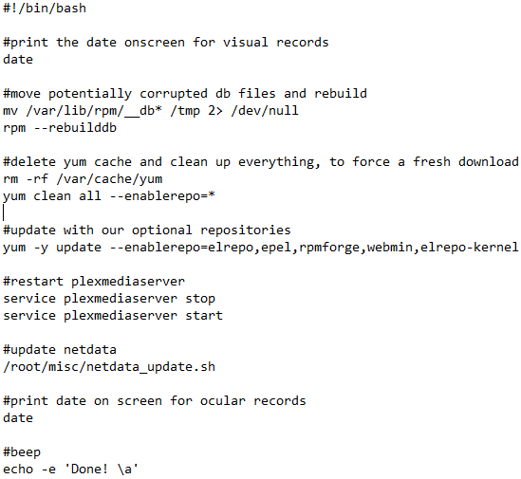
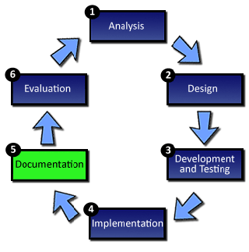
Documentation
Make things easily repeatable
Use commands and comments to make an actual script!
Test things
Automate testing?!
Example →

Slide 98
System Life Cycle
A method of breaking down the development of a new system into a logical set of stages, each of which are involved with specific tasks.
The SLC consists of the following stages:
Definition
Investigation and analysis
Design
Implementation
Testing
Installation
Documentation
Evaluation
Maintenance
Notes:
http://www.teach-ict.com/as_as_computing/ocr/H047/F451/312/slc_cycle/miniweb/index.htm

Slide 99
Assignment 11 Checklist
AWStats should be installed and have:
Config file at /etc/httpd/conf.d/awstats.conf
Crontab entry for root user
Responds to webpage requests
Read assignment 11 and run assignment 11 check script
https://jpatalon.cs.edinboro.edu/ecsc325/Assignment%2011.pdf
https://jpatalon.cs.edinboro.edu/ecsc325/classfiles/assignment11check.sh
Don’t forget to set script executable before running!
Documentation!
Parts of this assignment - 45 Points
AWStats configs
Backups of web files and WordPress database
MariaDB configuration optimization updates
System updates and reboot!
Info for assignment on last weeks slides!

Slide 100
Assignment 12 Checklist
Add a new network interface (enp9s0) with an additional VIP
Add VLAN 66 on the new network interface (enp9s0.66)
Create a new data LV in our cs VM , ext3 FS, and mount it at /data
Create a NFS export of /data only available to the VLAN 66 network
Mount the professors private VLAN 66 NFS mount at /110.data
Read assignment 12 and run assignment 12 check script
https://jpatalon.cs.edinboro.edu/ecsc325/Assignment%2012.pdf
https://jpatalon.cs.edinboro.edu/ecsc325/classfiles/assignment12check.sh
Don’t forget to set script executable before running!
Documentation!
Info for assignment on last weeks slides!

Slide 101
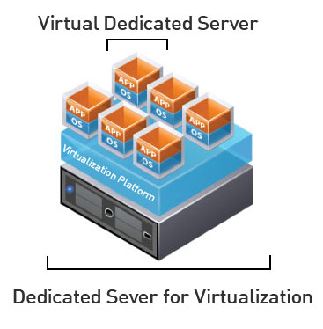
Virtual Machine Info
IP Address: 147.64.243.1##/23 (01-25)
Hostname: ecsc325-1##.cs.edinboro.edu (01-25)
Aliases:
31##.megastuff.biz, 1##.megastuff.biz, ##.megastuff.biz (01-25)
1##.ultrastuff.net, more?
Assignment 11 due April 2nd
Check script and upload in D2L!
Assignment 12 due April 9th
Check script and upload in D2L!
Accessing VM’s from off campus requires a connection to the CS VPN first, before opening a connection to your machine!
CS firewall prevents direct connections from other networks to our VM’s!
Once VPN is active: ssh user@ecsc325-1##.cs.edinboro.edu

Slide 102
Virtual Hosts
http://ecsc325-1##.cs.edinboro.edu, http://147.64.243.1##
PHP Info
http://ecsc325-1##.cs.edinboro.edu/phpmyadmin, http://147.64.243.1##/phpmyadmin
phyMyAdmin Website
http://1##.megastuff.biz/temp/temp.php
Temperature Graph Website
http://31##.megastuff.biz
index.html: Hello Megastuff Website
http://##.megastuff.biz, http://1##.megastuff.biz
TBD: Testing 123…
http://ecsc325-110.cs.edinboro.edu/awstats/ awstats.pl?config=localhost.localdomain
AWStats
http://ecsc325-1##.cs.Edinboro.edu/squirrelmail
Squirrelmail website
http://roundcube.##.megastuff.biz
Roundcube webmail
http://1##.ultrastuff.net
Ultra Modern Template Website
http://31##.ultrastuff.net
WordPress Website
https://ecsc325-1##.cs.edinboro.edu/private
Private web site!
https://a14.##.megastuff.biz
Assignment 14 web site!
Replace the ## with your 2 digit number!!!

Slide 103
Linux Commands
rsync
mysqldump
iptables
firewall-cmd
systemctl
yum
vi
nano

Slide 104
Key Terms and Items
Data Centers
Power Distribution Units
Cron/Crontab
Syslog/rsyslog
FirewallD
AWStats
Apache logging
RSync

Slide 105
For Next Week
Go confidently in the direction of your dreams. Live the life you have imagined.
Henry David Thoreau
Textbook:
Chapter 13: Netfilter Firewall
Next week topics
Security & Authentication
Finish work with VM’s
Assignment 11 due this week!
Assignment 12 due next week!
Just because all tests say OK, doesn’t mean everything is working properly!
I can’t write check scripts for every possibility…

